Slide 1
Emotions and Moods

Slide 2
Emotions and Moods
The “Myth of Rationality”
Believed to be disruptive and counterproductive
Tried to make emotion-free workplace
Emotions cannot be separated from the workplace
Importance influence on decision-making
Can be both positive and negative
Big topic in OB research currently
How to understand and utilize emotions?

Slide 3
The Functions of Emotions
Decision-Making
Thinking
Feeling

Slide 4
Influence of Emotions
Creativity
Motivation
Job satisfaction
Job involvement
Deviant behavior
Job safety & injury
Communication
Leadership
Negotiation

Slide 5
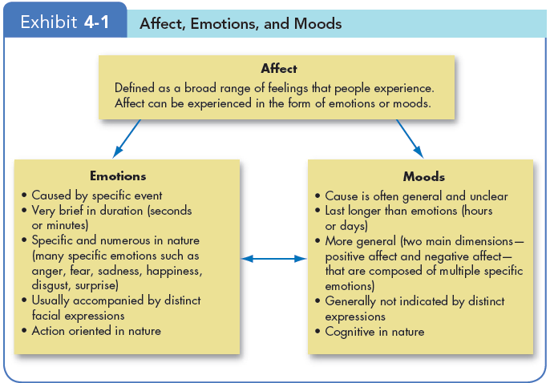
Emotions and Moods
Insert Exhibit 4-1

Slide 6
Emotions and Moods
Six basic emotions:
Anger
Fear
Sadness
Happiness
Disgust
Surprise

Slide 7
Emotions and Moods
Emotions may be placed along a spectrum of emotion
Happiness
Surprise
Fear
Sadness
Anger
Disgust

Slide 8
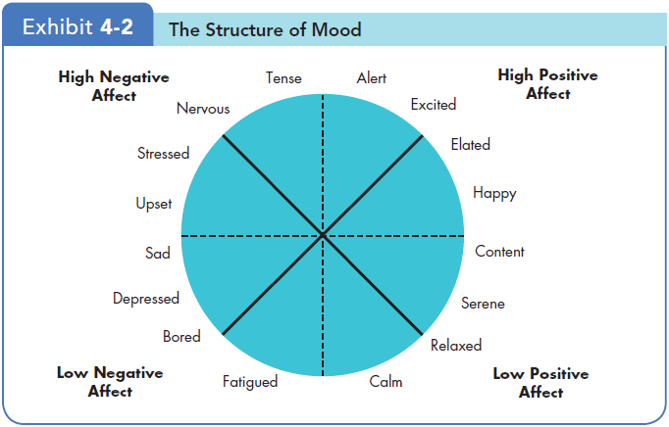
Emotions and Moods

Slide 9
Emotions and Moods
Emotion when nothing particular going on?

Slide 10
Sources of Emotions and Moods
Personality
Affect Intensity
Time of Day
Day of the Week
Weather
Illusory correlation
Stress
Social Activities
Exercise
Sleep
Age
Gender

Slide 11
Understanding and using emotion effectively

Slide 12
Emotional Intelligence
Emotional Intelligence
Identify
Empathize
Control
Influence
Communication
Leadership
Negotiation

Slide 13
Emotional Labor
An employee’s expression of organizationally desired emotions during interpersonal interactions at work
Types of Emotions
Felt:
Displayed:
Emotional Dissonance

Slide 14
Emotional Labor
Displaying fake emotions
Surface acting:
hiding one’s inner feelings and forgoing emotional expressions in response to display rules
Deep acting:
trying to modify one’s true inner feelings based on display rules
Difficulty?

Slide 15
Effects of Emotion
Selection
Hiring factor
Decision Making
Positive mood → better decisions
Creativity
Positive mood → flexibility, openness, and creativity.

Slide 16
Effects of Emotion
Motivation
Positive mood → expectations of success
Leadership
EI
Use
Negotiation
Use & protect

Slide 17
Effects of Emotion
Customer Service
Emotion → service → customer satisfaction
Emotional contagion:
process by which peoples’ emotions are caused by the emotions of others
Job Attitudes
Interaction between mood and job attitudes
Deviant Workplace Behaviors
Negative emotions → DWB
Safety and Injury at Work
Don’t do dangerous work when in a bad mood.

Slide 18
How to influence moods

